Slide 1
WELCOME Class: B.Com – Part-1 Subject: Financial Accounting TOPIC: Ledger
Prepared By
Dr. SHAHID IQBAL
Guest Faculty
Marwari College, Darbhanga,
Mobile No. and Whatsup No. : 7004160257
Email ID: shahidlnmu@gmail.com

Slide 2
ledger
After recording the transaction in the journal, the next stage is the transfer of transactions in the respective accounts opened in the Ledger.
Meaning of Ledger: -
A Ledger is a principle book which contains all the accounts (Assets Accounts, Liabilities Accounts, Capital Accounts, Revenue Accounts, Expenses Accounts) to which the transactions recorded in the books of original entry are transferred. As the ledger is the ultimate destination of all transactions, the ledger is called the ‘Book of Final Entry.’ It is considered as a permanent record and is more frequently referred to. It may be noted that an account is a forma record of all transactions relating to change in a particular item.

Slide 3
POSTING: -
Posting is the process of transferring the transactions recorded in the books of original entry in the concerned accounts opened in the ledger. It may be done daily, weekly, fortnightly or monthly according to the convenience and requirements of the business.
Necessity of Posting: -
It is necessary to post all journal entries into various accounts in the ledger because post helps us to know the net effect of various transactions during a given period on a particular account.

Slide 4
Steps to Prepare Ledger Account
So, the 5 simple steps for writing and preparing ledger are;
Drawing the Format – First draw the ledger format.
Posting transactions from journal to respective ledger account.
Folioing – Put the page number for a journal entry on the ledger account’s folio column.
Casting – Separating debit and credit amount.
Balancing – find the difference between debit and credit to get debit or credit balance of the account. .

Slide 5
Cash A/c
Format of Ledger
Date | Particulars | L.F | Amount | Date | Particulars | L.F | Amount

Slide 6
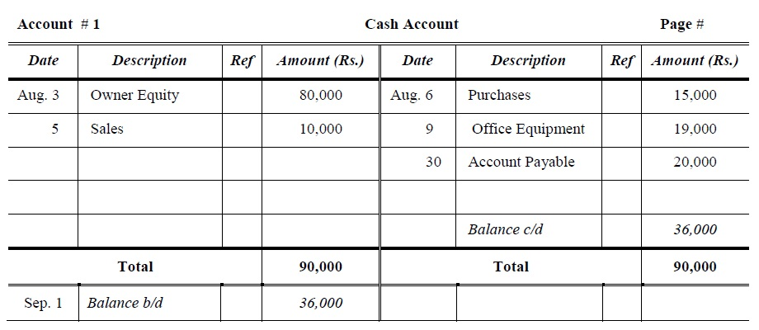
Example of Ledger

Slide 7
Thank You

